Slide 2
The purpose of this research was to apply prediction models to predict the trend of watching. I worked with data given by Netflix to get promising results for this multiclass challenge by combining different types of modeling and categorical feature engineering with a random forest, KNN Algorithms and Logistic Regression.
Objective

Slide 3
Summary of the Project
- Exploring the Data
- Check the variables that contains missing values
- Clean and Correct the missing values
- Exploratory Data Analysis (EDA) and Visualization
- Data Cleaning and Preprocessing with Pandas for modification
- Feature Selection
- Predictive Machine Learning Modeling

Slide 4
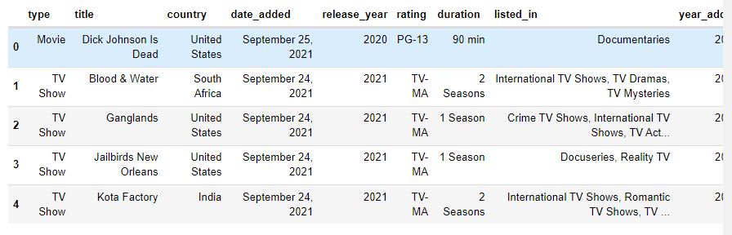
This dataset consists of TV shows and movies available on Netflix. It contains 7787 rows and 12 columns.
Data Description

Slide 5
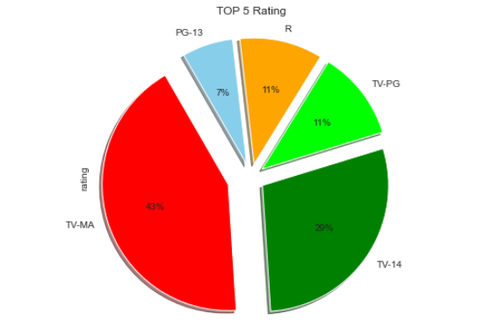
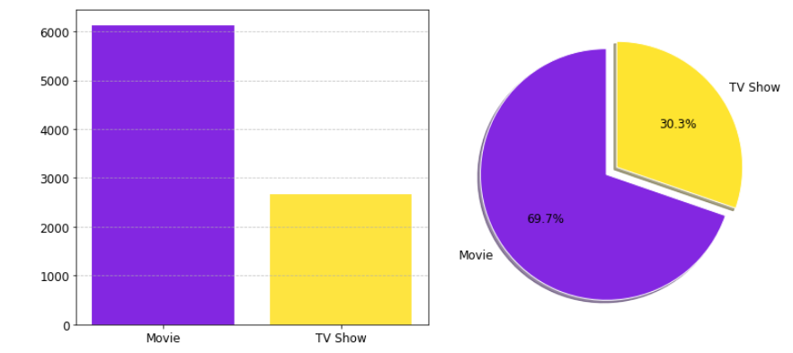
Exploratory data analysis on NETFLIX MOVIES AND TV SHOWS, EDA done using python, numpy, pandas, matplotlib, seaborn and plotly. You will find many useful visualizations and Tables in the project. I have tried to analyze most of the features of the dataset to derive insights.
Exploratory data analysis

Slide 6
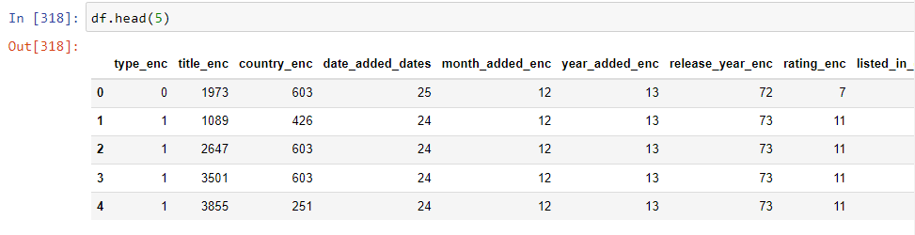
Cleaning and Preprocessing of the data before modelisaton, using different libraries and different method. as converting the text to numerical variables.
Cleaning and Preprocessing

Slide 7
Analysis using different types of Machine Learning Algorithms for classifying and predicting. using thee types of Algorithms; KNN, Random Forest and Logistic Regression.
Machine Learning Algorithms

Slide 8
Logistic regression, k-Nearest Neighbors, and Random Forest classifiers were used before settling on random forest as the model with strongest cross-validation performance. Random forest feature importance ranking was used directly to guide the choice and order of variables to be included as the model underwent refinement.
Machine Learning Algorithms

Slide 9
The full 7787-record training dataset was split 80/20 train vs. holdout, and all scores shown below were calculated using 5-fold cross validation on the training phase exclusively. Because predictions on the 20% holdout were limited to the very end, this split was only utilized once, and the scores were only viewed once.
Machine Learning Algorithms

Slide 10
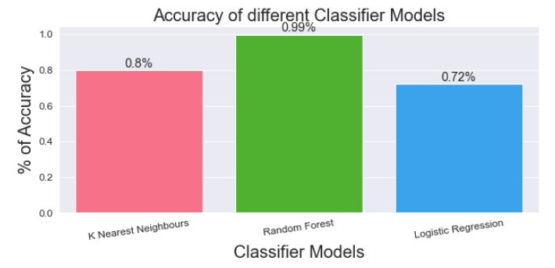
According the Figure we see that using Random Forest Algorithm gives a high accuracy results compared to KNN Algorithm and the Logistic Regression.
Results

